Slide 1

ALASKA AREA NATIVE HEALTH SERVICE
FEDERAL SUPERVISORS
  CAPT Kelly Leseman
  CAPT Steve Bolan
  CAPT Denman Ondelacy
ALASKA AREA COMMISSIONED CORP
  CDR Martha Wanca
    Western Region Liaison
  Stacy Turner
    HR Specialist

Slide 2

COER DATES TO REMEBER
November 18, 2016: COERs available to Officers online
December 14, 2016: COERs due to Rater
January 14, 2016: COERs due to Reviewing Official
February 01, 2016: COERs to DCCPR

Slide 3
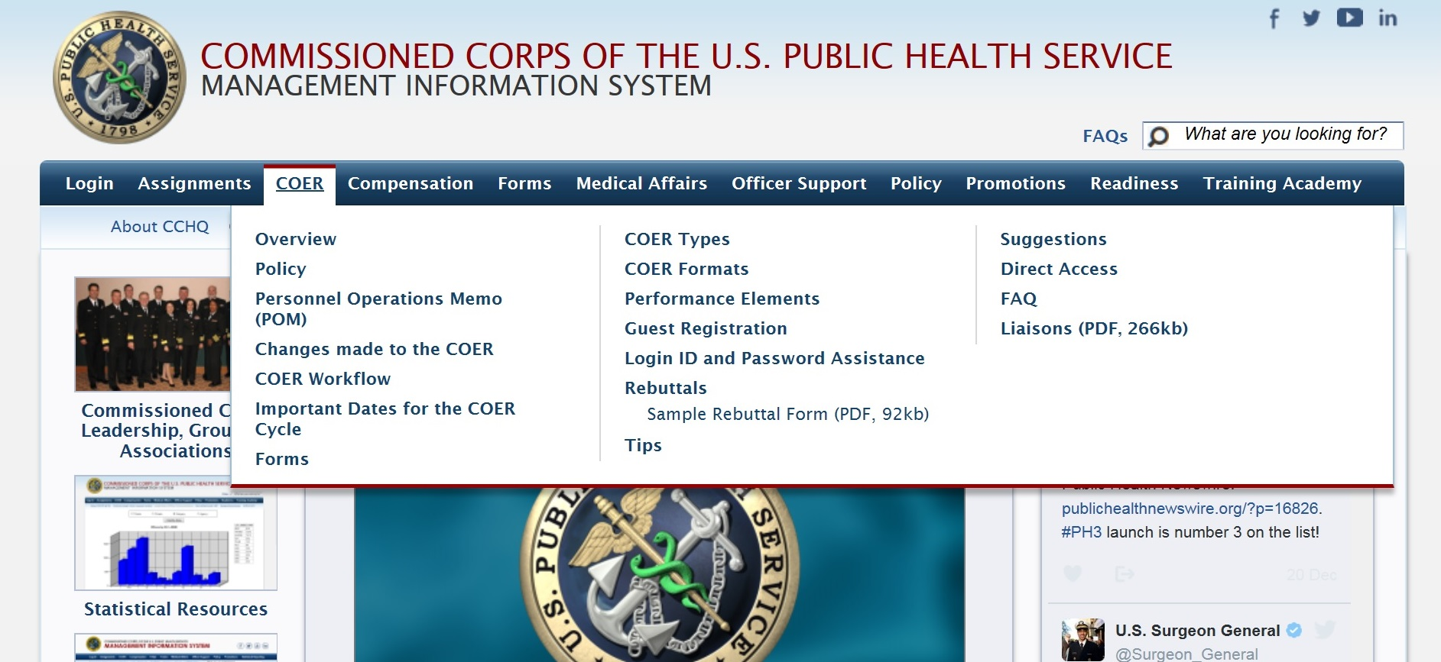
COER TAB CCMIS WEBSITE

Slide 4
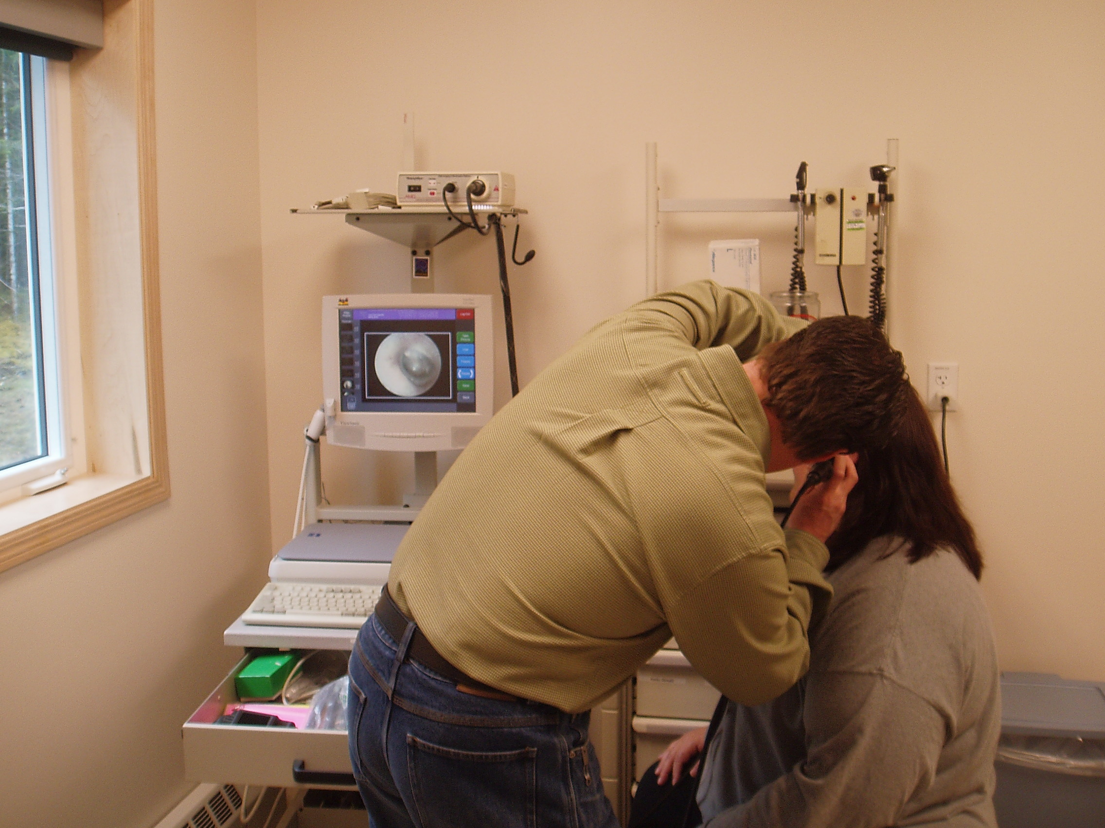
2016 COERs
+/- 300 COs, 3 Federal Supervisors
Federal Supervisors are Engineers.
Supplemental COER Guidance sent out in December. Some emails were returned as “Undeliverable.”
If unsure who your Federal Supervisor is, please contact us at the Alaska Area office. Don’t guess
Early submittals are encouraged.

Slide 5

SECOND LEVEL REVIEW
Determined by Individual Tribal Organization
Officer’s responsibility

Slide 6


WRITING STYLES
State as facts, not first or third person narrative
Be Concise
Use common acronyms where appropriate; avoid specialized acronyms.
Grammer counts!
Don’t get over technical
  “Developed Dispensary Protocols for Tri-phenazopyriddine-ondansetron-hydrochloroquinone”

Slide 7
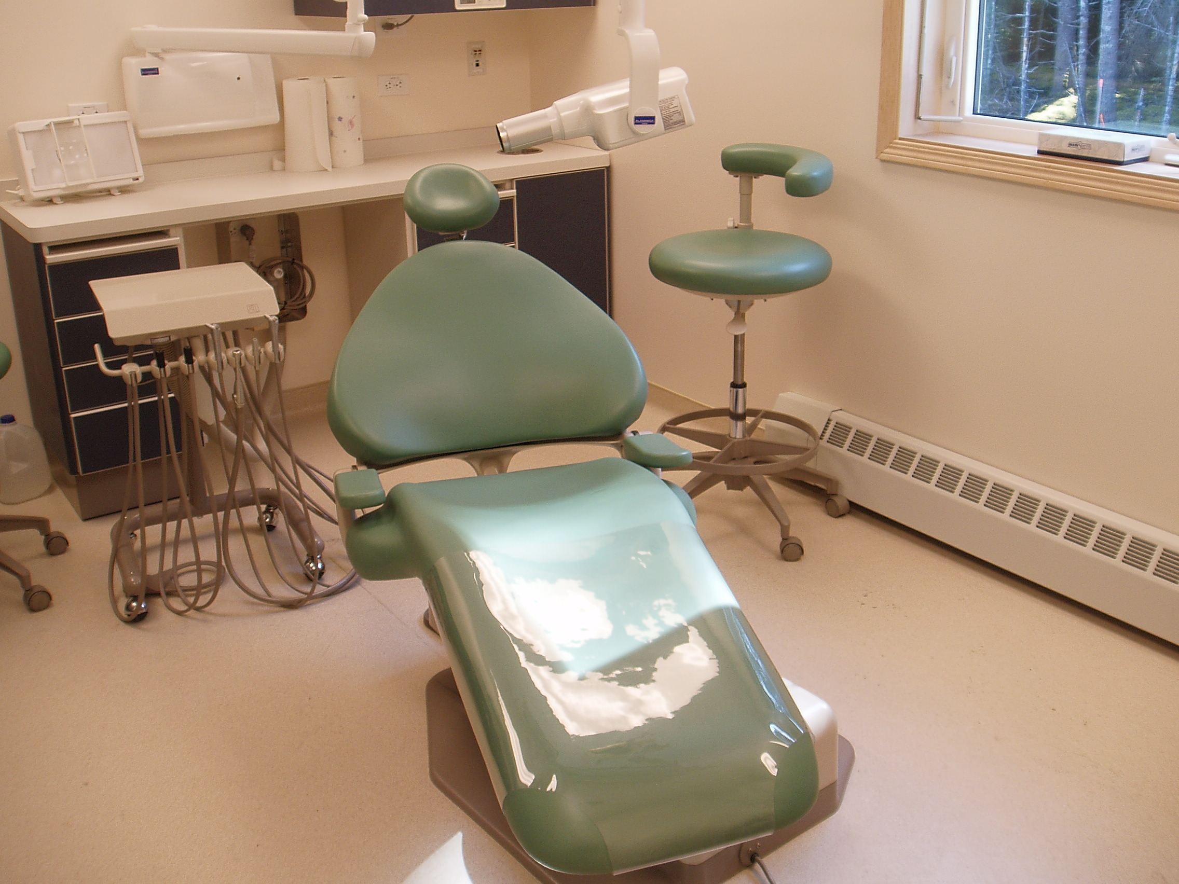
COER OFFICERS COMMENTS
DESCRIPTION:
  Title, Billet, position description
GOALS
  Should be quantifiable and measurable.
    Get better at technical writing
    Complete on-line course in technical writing
ACCOMPLISHMENTS
  For 2016 cycle only
  Quantifiable or Quality based accomplishments that demonstrate value-added outcomes
  Include collateral duties, volunteer efforts, committees, and activities pertinent to profession

Slide 8
EXAMPLE: DESCRIPTION
Assistant Chief Pharmacist (O-6 billet). Directly supervise 10 pharmacists & 6 techs; manage daily operations of ambulatory pharmacy with 1000 prescriptions daily and counsel 4800 patients/month combined; Oversee 4 clinical programs, and manage revenue collections of $25M annually; Acting Chief of Pharmacy and VP of Ancillary Services as needed.
During my performance period my duty has been to work as the Asst. Chief Pharmacist in the ambulatory pharmacy at the Alaska Native Medical Center. I oversee approx. 1043.6 prescriptions daily. Furthermore, I oversee the council of 5600 patients per month. In addition to these duties I also oversee 4 clinical programs and manage $25,247,578 annually. Sometimes I am the Acting Chief of pharmacy or VP of Ancillary Services.

Slide 9

COER SCORES
Extremely high or low scores, supervisor will likely be engaged to discuss.
If scores are predominately low, Officer encourage to discuss with supervisor before concurring

Slide 10
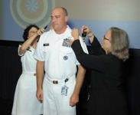
PROMOTION
Promotion Checklist
Curriculum Vitae (CV)
Officer Statement (OS)
Reviewing Officer Statement (ROS)
Professional Licensure
Force Readiness
Physical Exam/AFT

Slide 11
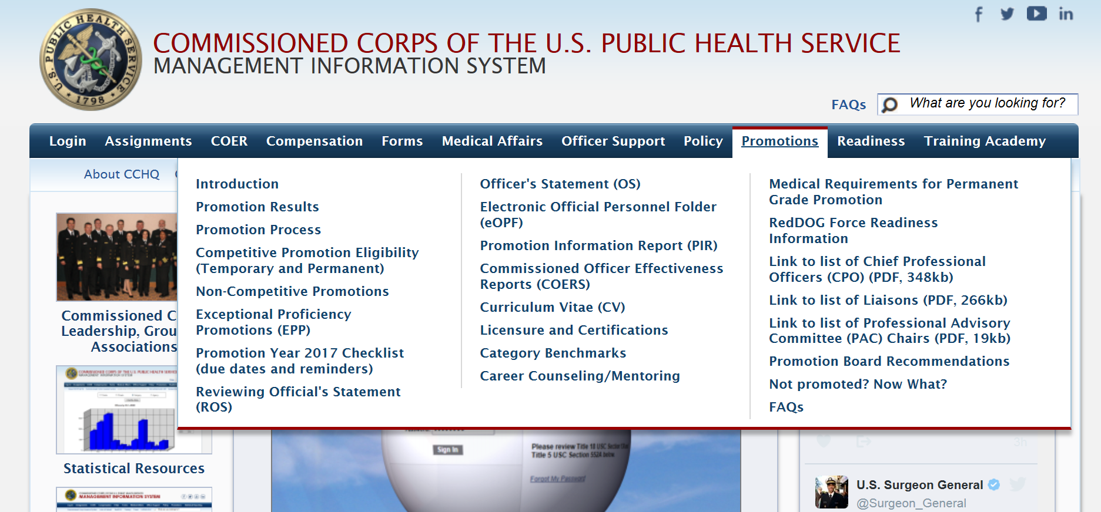
RESOURCES CCMIS WEBSITE

Slide 12
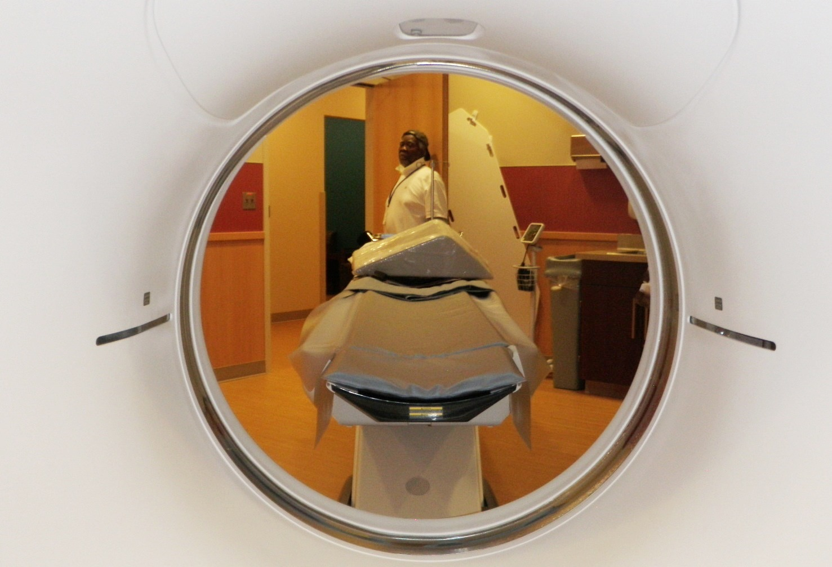
DATES TO REMEMBER
January 03, 2017: ROS to Reviewing Official
February 17, 2017 eOPF must be complete

Slide 13
OFFICER STATEMENT
Grammar Counts (same as COER statements)
  Concise
  Write in factual statements
Should be Reflective of COER
State Position, Title, and Billet

Slide 14
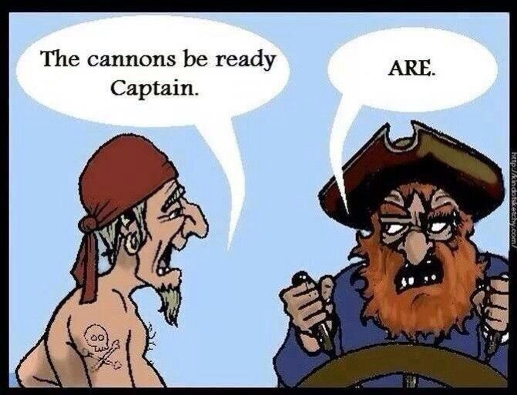
REVIEWING OFFICERS STATEMENT
Grammar really, really, really counts!
Must be in PDF editable format
Write in 3rd Person
Verify and state billet
Do not assume or fill in “highly recommend”
Should reflect COER narrative and scores

Slide 15

QUESTIONS

