Slide 1
Indian Health Service Corps Officers All-Hands
MAY 8, 2017

Slide 2
AGENDA
Key Leader Introductions
Purpose of the Corps All-Hands Meetings
Our Mission
Presentation of Commissioned Corps Topics and Updates
Question and Answer (Q&A) Session
Closing Remarks

Slide 3
Purpose
Keep officers in the field updated on Corps activities
Ensure officers receive the same information at the same time
Provide opportunity to interact with IHS Senior Staff and Flag Officers
Plan to have meetings at least quarterly
In between, officers will receive relevant Corps updates from CDR Mtungwa, Commissioned Corps (CC) Liaison and Regional CC Liaisons

Slide 4
Our Mission
Indian Health Service
...to raise the physical, mental, social, and spiritual health of American Indians and Alaska Natives to the highest level.

Slide 5
Our Mission
Public Health Service Commissioned Corps
... to protect, promote, and advance the health and safety of our Nation.
Department of Health and Human Services
... to protect, promote, and advance the health and well-being of all Americans.

Slide 6
Reimagine HHS Initiative
Plan to reorganize and optimize our work at HHS
Six principles outlined
Engagement
Empowerment
Service
Performance
Stewardship
Sustainability

Slide 7
Reimagine HHS Initiative
Draft Plan is due to the Office of Management and Budget on June 30th
Plan will be based on ideas from HHS employees through 5 interagency workgroups focusing on:
The Healthcare System
Public Health
Economic and Social Well-Being
Scientific Advancement
Management and Stewardship
Ideas may be submitted to ReimagineHHS@hhs.gov

Slide 8
IHS Corps Force Strength
IHS Area | Total
Albuquerque | 127
Alaska | 286
Billings | 68
Bemidji | 82
California | 30
Great Plains | 147
Headquarters | 76
Nashville | 49
Navajo | 277
Oklahoma City | 297
Phoenix | 306
Portland | 97
Tucson | 41
Grand Total | 1883
Currently 1883 Officers Assigned
Represents 29% of the total Corps force strength of 6502 officers

Slide 10
2017 COF Symposium
The Commissioned Officer Foundation (COF) Scientific and Training Symposium will be held in Chattanooga, TN from June 6-9, 2017
IHS authorized to support 150 officers to attend
Current total of supported officers is just over 100
Important for IHS to be well-represented at Corps meetings
An IHS booth will be set up in the Exhibit Hall; stop by and say hello
Working to secure space for a potential IHS Corps officer meeting

Slide 11
PMAP
The Annual PMAP is no longer required for Commissioned Corps officers.
The Indian Health Manual was revised to incorporate this change.
Transmittal Notice: https://www.ihs.gov/ihm/index.cfm?module=dsp_ihm_tn_2010_19&tn=ihm_tn_17-12
Directive:
https://www.ihs.gov/ihm/index.cfm?module=dsp_ihm_pc_p7c7

Slide 12
New Secure CCMIS Single Sign-on
New log-in to the CCMIS Secure Area will go live on May 15, 2017
A HSPD-12 (CAC or PIV card) and card reader will be required for the first log-in.
Officers will complete a one-time process to:
Link a user name and password; and/or
Link a mobile phone to their AMS account
After initial set up, officers can also log in to CCMIS via a user name and password or linked mobile phone (without a card reader).
Notes:
6. New Secure Single Sign-on to the CCMIS Secure Area
a. HHS has required the CCMIS secure area log-in to be more secure using a HSPD-12 card.
b. Once the new system is implemented, officers will have to complete a one-time process to link a user name and password and their mobile phone to their AMS account.
i. For this one-time process, an HSPD-12 card (PIV or CAC) is required.
ii. Officers can then establish a user name and password and register a personal or government mobile phone that will be linked to the AMS account.
c. Upon successful registration, officers may log in to CCMIS in one of three ways:
i. Using the PIV or CAC in a card reader; or
ii. Using the established user name and password; or
iii. Using the linked mobile phone
d. So a card reader, PIV, or CAC will not be necessary to log in to the CCMIS website after the initial one-time linkage of a user name/password and/or mobile phone, unless the mobile phone changes.
e. DCPS has performed a needs assessment and with the information, will ship card readers to service units that lack them currently.
f. Expected completion by May 15th when the new sign on is implemented.
g. Contact regional liaison with questions.

Slide 13
New Secure CCMIS Single Sign-on
The Division of Commissioned Personnel Support (DCPS) sent a survey to all IHS officers to identify:
The need for a card reader
The availability of an unexpired working HSPD-12 (CAC or PIV) card
Card readers will be shipped to service units that lack them
Officers without a working CAC or PIV card will be contacted with instructions to resolve the issue.
Contact your Regional CC Liaison Office with questions or concerns

Slide 14
VA – Corps Agreement
On April 13th, the Surgeon General announced a formal partnership between the Corps and the VA to provide direct patient care to veterans in VA facilities
The agreement is for an initial 5-year commitment and a limited number of officers may be assigned initially, with new recruits receiving preference
How does it impact officers at IHS?
Initially it should not affect current IHS officers
The Office of the Surgeon General has expressed their intention to mitigate impact on recruitment and retention at IHS locations

Slide 15
Recruitment Efforts
As of May 1, 2017, IHS established a new recruitment initiative with Corps HQ that gives IHS priority in reviewing Corps applicant leads
Facilitated by the Division of Recruitment and Outreach (DRO) and Division of Commissioned Personnel Support (DCPS) within the Office of Human Resources
Leads will include those that pass the initial pre-screen; those that are professionally boarded; those ineligible for the Corps or have withdrawn their application, but may be interested in a Civil Service position
Previous coordination effort with Corps HQ on the GPA initiative resulted in 10 Nurse hires and counting
Notes:
a. OHR/DRO and DCPS in coordination with GPA, NAV, and BIL Area Offices and service unit staff are working with Corps HQ to prioritize IHS in contacting and hiring Corps applicants.
b. Initiative began on May 1. IHS will receive a head start in contacting those interested in the Corps for an expedited hiring process.
c. Leads will include those who contact the Call Center; those who are not commissionable due to age, height/weight, or withdrew their application, but may be interested in a Civil Service position; those who have been recommended by an appointment board but do not have a job; those who missed the cut-off when the number of applications exceeded the number accepted.
d. Previously worked with Corps HQ on a GPA Initiative that resulted in 10 Nurse hires and counting.

Slide 16
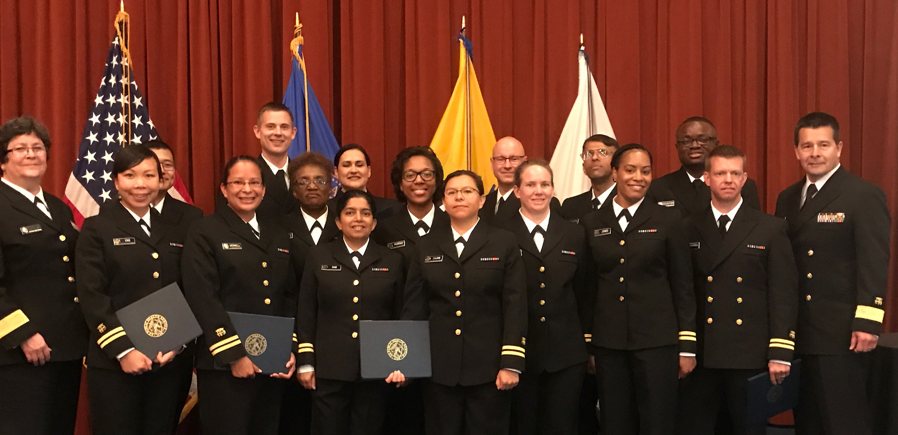
RADM Chris Buchanan and RADM Kelly Taylor with newly commissioned IHS officers at the graduation ceremony of Officer Basic Course (OBC) 95 on April 21, 2017 in Potomac, MD.

Slide 17
Office of the Surgeon General Workgroups
OSG is chartering workgroups focused on these three areas:
Executive Leadership Training/Development Plans for Officers
Development of a Communications Plan for the OSG
Community Engagement specific to OSG initiatives
Beginning with the Surgeon General’s report on Addiction

Slide 18
Call for Flag Nominations
Current O-6 officers in Executive Level positions may be nominated for promotion to Flag Grade (O-7).
Eligibility
At least 16 years of active duty service in the Uniformed Services
At least 12 years of active duty service in the PHS Commissioned Corps
Encumbering an executive level position
A minimum of 3 years in the O-6 grade as of January 1, 2016
Meet all administrative requirements
The deadline for submission of applications through the IHS Area/Office Director is June 1, 2017.

Slide 19
National Nurses Week
National Nurses Week
is May 6-12, 2017
See IHS-ALL email message from CAPT Michael Toedt,
Acting Chief Medical Officer, on May 8, 2017

Slide 20
Questions and Answers (Q&A)

Slide 21
Regional Commissioned Corps Contacts
Region | Area Covered | DCPS Liaison Office Contact | Phone | Email
IHS | Agency/Headquarters | CDR Angela Mtungwa, Director Mr. Maurice Sloan, Deputy Director | 301-443-5440 480-225-1944 | Angela.Mtungwa@ihs.gov Maurice.Sloan@ihs.gov
Navajo | Navajo | Ms. Deborah Damon, HR Specialist | 928-871-1390 | Deborah.Damon@ihs.gov
Northern Plains | Bemidji, Billings, Great Plains | Ms. Robin Davidson, Regional Liaison | 605-355-2244 | Robin.Davidson@ihs.gov
Southeast | Albuquerque, Nashville, Oklahoma City | CAPT Brandon Taylor, Regional Liaison | 405-951-3819 | Brandon.Taylor@ihs.gov
Southwest | Phoenix, Tucson | CDR Stephen Navarro, Regional Liaison | 602-364-5252 | Stephen.Navarro@ihs.gov
Western | Alaska, California, Portland | CDR Martha Wanca, Regional Liaison | 907-729-1308 | Martha.Wanca@ihs.gov

