Slide 1
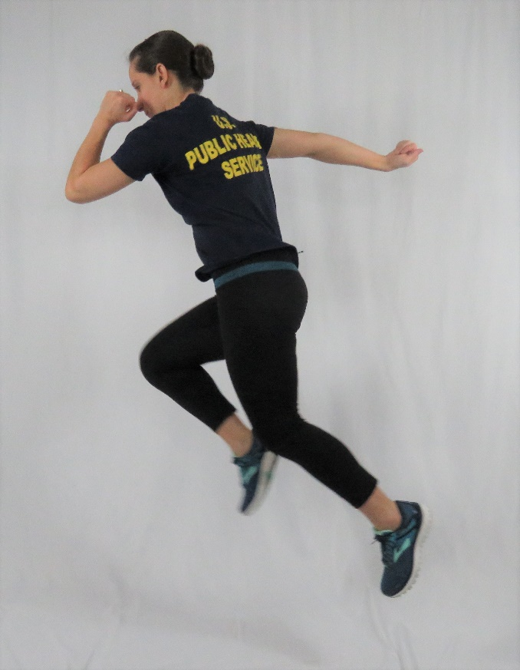
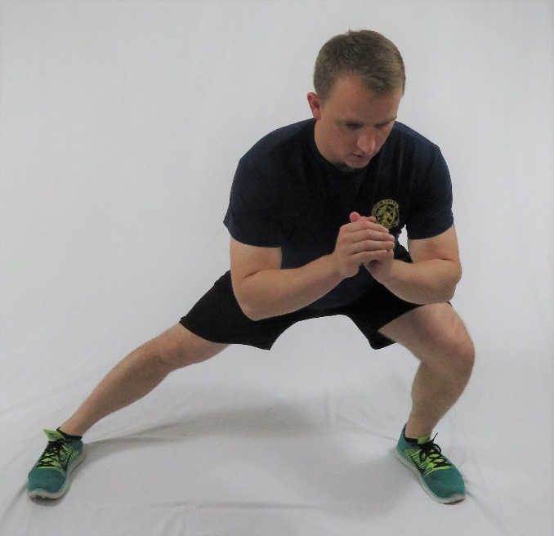
TPAC Exercise Challenge
150 Minutes for 15 Weeks
Move MORE, Sit LESS

Slide 2
TPAC Exercise Challenge
What is the Exercise Challenge?
When does it start?
The Exercise Challenge consists of exercising for at least 150 minutes for 15 weeks!
For each week that you report 150 minutes of exercise you will receive 1 point.
All Officers with 10 points or more will receive a Letter of Appreciation
May 8th 2019
Who do I contact about joining?
Please contact CDR Michael Rinaldi Mrinaldi@bop.gov or LCDR Clara Stevens C1stevens@bop.gov if you have any questions.

Slide 3
Why 150 Minutes?
According to the 2018 HHS Activity Guidelines
Adults should do at least 150 to 300 minutes a week of moderate-intensity, or 75 minutes to 150 minutes of vigorous-intensity aerobic physical activity, or an equivalent combination of moderate/vigorous-intensity aerobic activity.
Additional health benefits are gained by engaging in activity beyond the equivalent of 300 minutes of moderate-intensity activity a week.
Adults should also do muscle-strengthening activities of moderate or greater intensity and that involve all major muscle groups on 2 or more days a week

Slide 4
How to Participate – 2 ways
1) Exercise and then email your results
2) Join the Challenge online and we will keep track for you
You can manually track your minutes them and email CDR Rinaldi MRinaldi@bop.gov and he will keep track of each week that you reach your goal.
Please email him by Midnight every Wednesday.
Sign up and join the challenge on the Lose It App and we will track your minutes for you!
Log all your weekly minutes by Midnight on Wednesday. If you are late logging minutes, please email CDR Rinaldi to let him know.
The App is also a great way to track calories for weight management as well.
REMEMBER: You need 10 points or successful completion of obtaining 150 minutes of exercise for 10 weeks of the 15 weeks to receive a Letter of Appreciation.

Slide 5
Step 1: Download the Lose It! App on your smartphone or view the website at www.loseit.com

Slide 6
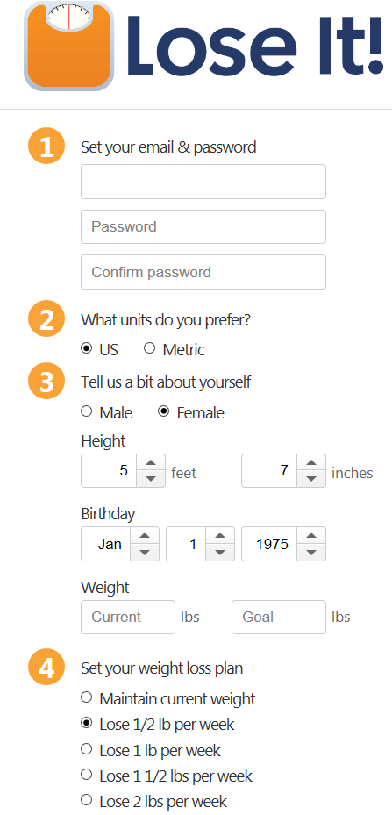
Step 2: Follow the links to create a Lose It profile.
Please use personal email address
Profile can have as much or as little information as you like. First name only, nicknames, etc.
IMPORTANT: Please email CDR Rinaldi your user name so that we know who you are and can email you your Letter of Appreciation upon successful completion of the challenge!

Slide 7
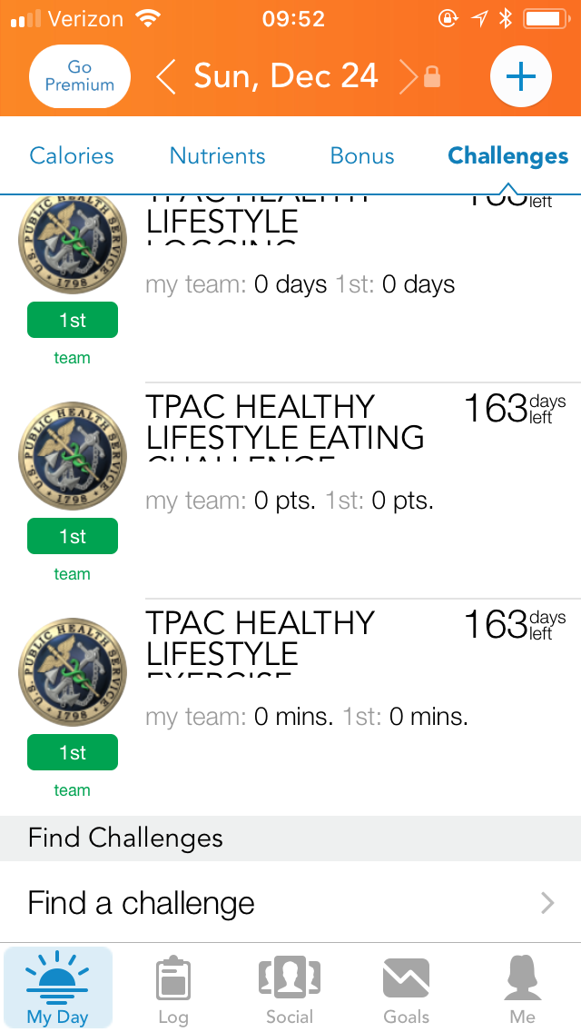
Step 3: Click the “My Day” Tab
This will take you to a screen similar to the one shown to the left. Near the bottom of the page is, “Find a challenge.
Click on this and type, “TPAC Exercise Challenge” and join the challenge

Slide 8
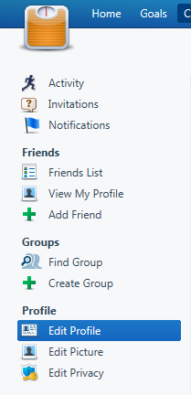
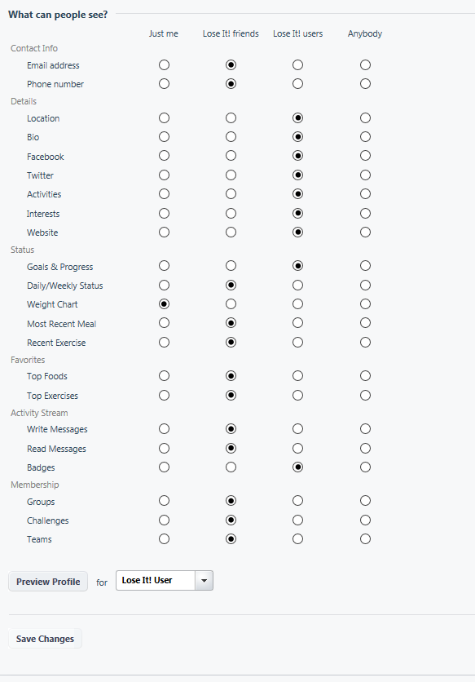
Step 4: Set privacy settings on Lose It website
Limited options to set privacy settings on the application. Please set privacy settings via the www.loseit.com website.
Left panel menu available after clicking on your name or

Slide 9
Step 5: Start logging your meals and exercise.

Slide 10
Still not convinced that you should join….
PLEASE KEEP READING

Slide 11
Fit for duty?
Fit for Duty?
**Almost 1 in 5 children and more than 1 in 3 adults in the U.S. struggle with obesity**
**Only half of adults and about one quarter of youth get recommended amounts of aerobic physical activity**
**Nearly 1 in 4 young adults are too heavy to serve in our military**
Notes:
CDC. (2017). Unfit for Duty. Retrieved at: https://www.cdc.gov/physicalactivity/downloads/unfit-to-serve.pdf

Slide 12
USPHS Service Weight Standards
Height (inches) | BMI 19.0 – 27.5 (Weight in pounds)
58 | 91 – 131
59 | 94 – 136
60 | 97 – 141
61 | 100 – 145
62 | 104 – 150
63 | 107 – 155
64 | 110 – 160
65 | 114 – 165
66 | 117 – 170
67 | 121 – 175
68 | 125 – 180
Height (inches) | BMI 19.0 – 27.5 (Weight in pounds)
69 | 128 – 186
70 | 132 – 191
71 | 136 – 197
72 | 140 – 202
73 | 144 – 208
74 | 148 – 214
75 | 152 – 220
76 | 156 – 225
77 | 160 – 231
78 | 164 – 237
79 | 168 – 244
80 | 173 – 250
Effective
10/01/18

Slide 13
How to Determine Intensity? Find Your Target Heart Rate
What is normal RESTING heart rate?
Average resting heart rates (taken after a good night’s sleep and before getting out of bed) are:
60-100 beats per minute for adults and children 10 years and older
40-60 beats per minute for well-trained athletes
HOW TO FIND: Gently press down on the inside of your wrist (just below your thumb) until you feel your pulse.
Count the number of beats you feel for 15 seconds, and multiply by 4 to determine your heart rate (beats per minute).
Notes:
HOW DO YOU DETERMINE how much intensity you are exercising with? One way is by your Heart Rate
Image retrieved at: https://www.cdc.gov/dhdsp/maps/dtm/images/heart-image.jpg

Slide 14
Heart rate during exercise
What is my MAXIMUM heart rate?
The fastest heart rate your cardiovascular system can handle safely is approximately: 220 minus your age
What should my heart rate be DURING AEROBIC EXERCISE?
In general, you want to exercise between 50% and 85% of your maximum heart rate for cardiovascular benefits
To calculate: (220-age) x 0.50 , for 50% of max. heart rate
(220-age) x 0.85, for 85% of max. heart rate
If just starting to exercise, aim for the lower range of this (about 50% of max. heart rate)
For a moderate intensity workout, aim a little higher (50-69% of max. heart rate)
For a higher intensity workout, aim for 70-89% of your maximum heart rate
Notes:
Image retrieved at: https://www.cdc.gov/dhdsp/maps/dtm/images/heart-image.jpg
CDC. (2015). Target Heart Rate and Estimated Maximum Heart Rate. Retrieved at: https://www.cdc.gov/physicalactivity/basics/measuring/heartrate.htm
The talk test is a simple way to measure relative intensity. In general, if you're doing moderate-intensity activity you can talk, but not sing, during the activity. If you're doing vigorous-intensity activity, you will not be able to say more than a few words without pausing for a breath.
What should my heart rate be DURING AEROBIC EXERCISE?
In general, you want to exercise between 50% and 85% of your maximum heart rate for cardiovascular benefits
To calculate: (220-age) x 0.50 , for 50% of max. heart rate
(220-age) x 0.85, for 85% of max. heart rate
If just starting to exercise, aim for the lower range of this (about 50% of max. heart rate)
For a moderate intensity workout, aim a little higher (50-69% of max. heart rate)
For a higher intensity workout, aim for 70-89% of your maximum heart rate
According to the American Heart Association, most people can gradually work up to exercising comfortably at 85% of their max. heart rate after a few months of regular exercise

Slide 15
Muscle Strengthening
Total body muscle strengthening targets the legs, hips, back, abdomen, chest, shoulders, and arms.
Examples: Lifting weights, working with resistance bands, push-ups, pull-ups, burpees, sit-ups, heavy digging or shoveling, or yoga.
Both aerobic exercise and strengthening can occur on the same day.

Slide 16
Muscle strengthening
To gain health benefits, muscle-strengthening activities need to be done to the point where it's hard for you to do another repetition without help.
A repetition is one complete movement of an activity, like lifting a weight or doing a sit-up.
Try to do 8—12 repetitions per activity that count as 1 set. Try to do at least 1 set of muscle-strengthening activities, but to gain even more benefits, do 2 or 3 sets.

Slide 17
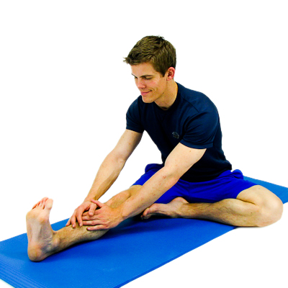
Flexibility
TIPS:
When static stretching, don’t bounce. Stretching should be a smooth movement; bouncing can lead to injury.
Don’t aim for pain. You should feel tension in the muscles being stretched, but not pain.
Don’t hold your breath, breathe normally.
The purpose of stretching is to maintain or increase the flexibility of tissues.
Dynamic stretching moves the limb through the entire range of motion. Repeat these stretches several times after a brisk warm up.
Static stretching is done by holding the stretch for a prolonged period of time. Static stretching should be held between 15-30 seconds for 2-4 repetitions. This is usually done after an activity.
Notes:
Bring movement into stretching.
Try doing Yoga or Tai Chi
Stretch on a regular basis, to maintain the benefits that stretching has to offer.
Gentle stretching can improve your circulation and steady blood flow helps reduce muscle tension and soreness.

Slide 18
Show your Esprit De Corps!
Need help setting it up?
Find us at the TPAC Wellness Booth during the 2019 COF USPHS Symposium.
You can also email CDR Michael Rinaldi at: Mrinaldi@bop.gov for Lose it! App technical related questions.

