Slide 1

Preparing for Promotion
Success
CAPT Angela Mtungwa
Former Promotion Coordinator
U.S. Public Health Service
Commissioned Corps
Notes:
Commissioned Corps Liaison Staff in your respective Region or HQ should be your primary POC and are available to assist you and advocate whenever appropriate. Please use this valuable resource. CAPT Mtungwa may also be contacted when needed. https://www.ihs.gov/dcps/

Slide 2
Agenda
Begin with the Benchmarks
Purposeful Promotion Documents
Administrative Requirements
Take-aways
Where to Find Help

Slide 3
BEGIN WITH THE BENCHMARKS

Slide 4
The Benchmarks
Levels of achievement for each Category and grade
Benchmarks determine the “best qualified” officer
Each officer is compared to the best qualified officer
Benchmarks are Guidelines, not requirements
Most often adversely affected for IHS officers: Awards, Billet, Mobility, Officership Activities
Notes:
Each Category or Discipline has developed benchmarks that it feels depicts the qualities of a well balanced officer who they consider would be the best qualified.
Benchmarks are guidelines, not requirements.
It is not essential that “all” of the benchmarks are met but you should determine those that are critical for your discipline and career pathway and work toward meeting them.

Slide 5
Promotion Precepts
(Applicable to All Competitive Promotions)
Precept | What’s included? | Wt.
Performance rating and ROS | COERs, awards, ROS | 40%
Education, Training, & Prof. Development | License, Advanced Degrees, Certifications, CEUs, Public Health and Leadership Training | 20%
Career Progression/ Potential | Increased responsibility, billet, mobility, collateral duties | 25%
Prof. Contributions, basic readiness history, and service to the Corps | PAC, advisory groups, recruitment, mentoring, PHS support activities, BASIC READINESS | 15%
Notes:
Each precept is weighted. Performance (40%) is the heaviest.
**** Therefore an officer’s performance, which he/she can control, can greatly help or hinder your chances of promotion. There must be a balance. You should participate in PHS support activities but not to the extent that your performance suffers.
Precepts 1 – 4 are scored by the Board. Readiness is now (as of PY2020) reviewed by the board and may be taken into account in Precept 4 “Officership”
Readiness no longer plays a role in the determination of the total numerical score or the rank order list. HOWEVER, basic readiness is still an administrative requirement. You must meet AND maintain basic readiness to be promoted. This may change in the near future. Boards may begin to see the readiness history, so it is important to always maintain readiness.

Slide 6
Benchmarks:
Common Pitfalls
Awards
Reviewing Official Statement
Billet
Mobility
Officer Statement
Commissioned Corps Activities
Notes:
Awards – many IHS officers don’t have awards; DCPS is working to revamp the program and make it easier. Everyone has accomplishments for which they can be awarded; consider the conversation with your supervisor about his/her willingness to nominate you, and be ready to specify those things you feel are award-worthy; Also be prepared to draft it.
ROS – sometimes not well-written because RO doesn’t have time. Give them plenty of time by notifying early. Offer to prepare bullets or a draft. More to come in later slide.
Billet – very hard to get promoted if not in the billet equivalent to the grade for which you are being reviewed. Example: should be in an O-6 billet if eligible for promotion to O-6. Ensure you list Collateral Duties and identify them as such on the CV
Mobility – many IHS officers lack it, but in IHS it is desired to remain and establish relationships with stakeholders. Address it in documents. We’ll talk about how in subsequent slides.
Officer Statement – ensure it is well-spaced, clear and bulleted, and focused on PHS activities, not IHS duties. More details in subsequent slides.
Corps activities – may have more than you think. Think of community and tribal activities in which you represent the Corps. Or could.

Slide 7
PURPOSEFUL
PROMOTION DOCUMENTS

Slide 8
Purposeful Promotion Documents
Curriculum Vitae (CV)
Category format
Highlight important, impactful information
Streamline it to address the benchmarks
Consider the audience
  Diversity of fields/expertise
  Time constraints
Address job/career-related weaknesses
Back up statements with documentation
Notes:
If you bold or underline too much, nothing stands out
The CV in the eOPF is specifically geared toward Corps boards, not getting a job or any other primary purpose.
Submitted through eDOCU
In line with your category’s recommended CV format: specifically identify collateral duties as a subsection of your current position and previous positions or specify in parentheses any duty that was a collateral duty. Without you specifying, board members won’t know which duties are a part of your PD and which are collateral.

Slide 9
Purposeful Promotion Documents
Officer Statement (OS)
One page document for officers to summarize:
    Your support of PHS activities
    Your commitment to visibility as an officer
    Your vision and expectations of a career in the PHS Commissioned Corps, including commitment to the mission
Submitted through eDOCU
Must be on the current year’s form
Notes:
Must sign and date it
This one page document that you prepare and submit through eDOCU. The Officer’s Statement (OS) should be written using succinct bulleted statements.
It is a fillable form so you can type directly into it.
It is essential that the bullets describe not just what organization officers are members of, but what they have contributed to those committees or groups. Board members will make a distinction between contributions and just membership on paper.
The OS can be found on the Promotion Information Website (CCMIS website, Promotions menu). The promotion board will only have access to the current year’s OS; they will not see any other OS submitted from previous years. Therefore, an officer must submit a new OS every year the officer is eligible for permanent or competitive temporary grade promotion and on the current year’s form
Ensure you enter the correct document date when uploading the OS in eDOC-U. January 31 of the Promotion Year. For PY2020, 1/31/2020; for PY2021; 1/31/2021, etc.
The OS is not related to the COER, but will be indexed in the COER Documents section of the eOPF.

Slide 10
Purposeful Promotion Documents
Officer Statement (OS)
Support of PHS activities
  Professional advisory committee (PAC)
  Mentoring – as the mentor or the protégé
  Tier 1 or 2 Deployment Team and/or Deployments
  Commissioned Officers Association involvement
  Surgeon General sponsored advisory groups
    JOAG, MOLC, AIANCOAC, BCOAG, SOAGDAG, etc.
  Aide-de-camp
Notes:
Should cover whole career or most recent and impactful if you have too many to list. Board members do not see your previous promotion documents so don’t think you only have to list things since your last promotion. They won’t see those previous activities unless you include them.
Keep it well-spaced with some white space/a blank line between sections. Board members will be viewing thousands of docs on the screen, so make it easy for them to see your accomplishments. Too much information without white space makes it all run together.

Slide 11
Purposeful Promotion Documents
Officer Statement (OS)
Commitment to visibility as an officer
  Activities (generally outside the duty station in uniform) that bring positive attention to the Corps
    Community Health Fair
    Career Day at Children’s School
    Recruitment
    Presentations in uniform
    Publications
    Professional Org - committee/workgroup/association participation

Slide 12
Purposeful Promotion Documents
Officer Statement (OS)
Vision and expectations of a career in the Corps
  “Career” not just the next year or two
  Avoid flowery, generic statements
  Do not focus solely on IHS or Alaska or current organization
  May expand on what you are already doing
    How you can use the degree/certification you are obtaining in the future
    Continuation of current work on a larger scale, at the next level
  Typically the shortest of the three parts of the OS

Slide 13
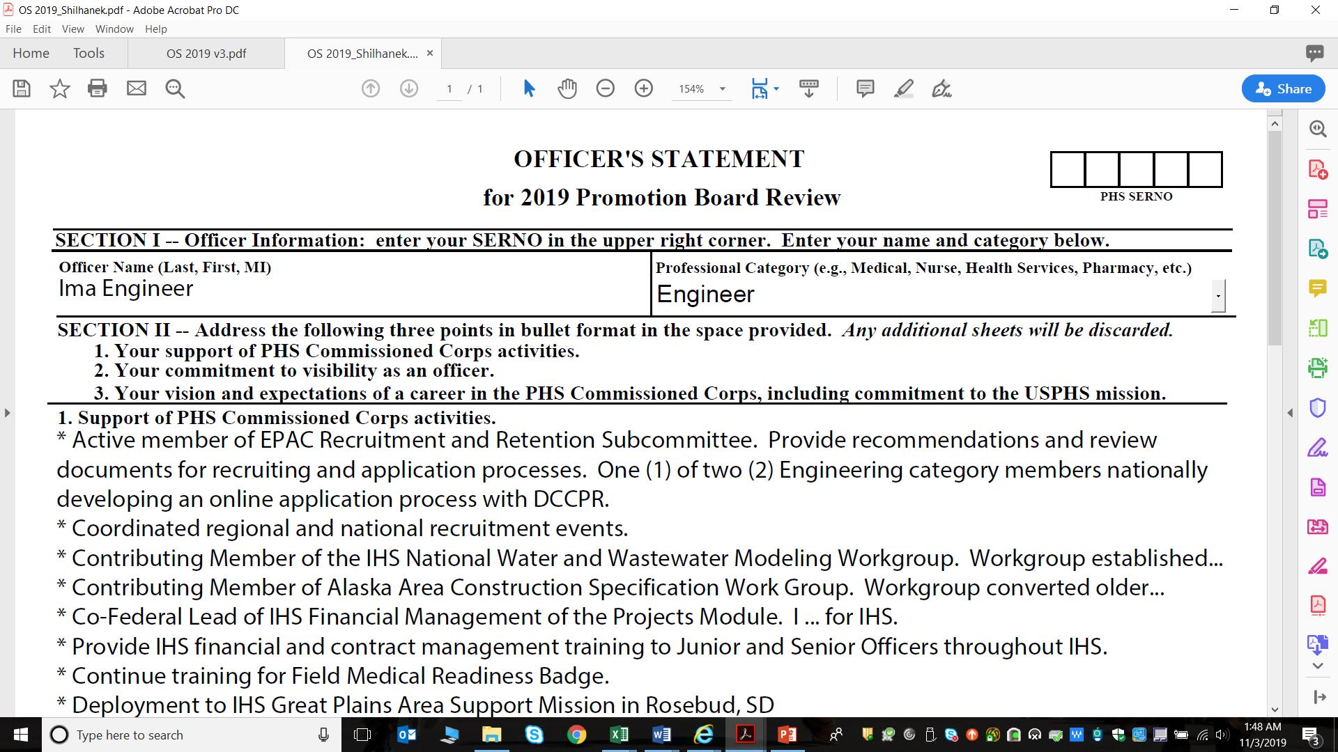
Purposeful Promotion Documents
Officer Statement (OS)
Notes:
Statements that pertain only to IHS duties should be removed
Do not regurgitate how many awards you have received, as it is on your CV and in and of itself is not officership. You can list a PHS support activity then add that you received a [specify award] as a result. But awards themselves are not officership.

Slide 14
Purposeful Promotion Documents
Officer Statement (OS)
Notes:
Should cover whole career or most recent and impactful if you have too many to list. Board members do not see your previous promotion documents so don’t think you only have to list things since your last promotion. They won’t see those previous activities unless you include them.
Keep it well-spaced with some white space between sections. Board members will be viewing thousands of docs on the screen, so make it easy for them to see your accomplishments. Too much information without white space makes it all run together.

Slide 15
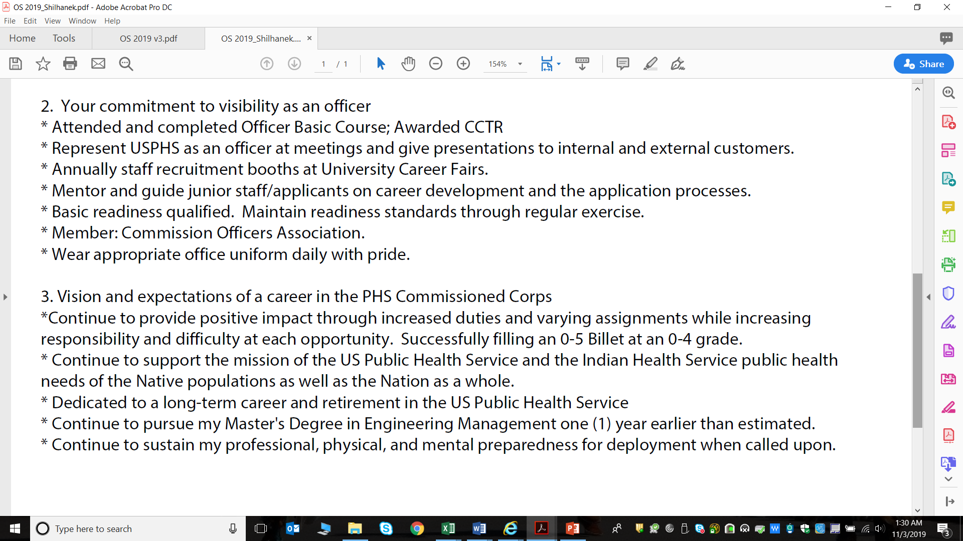
Purposeful Promotion Documents
Officer Statement (OS)
Notes:
Should cover whole career or most recent and impactful if you have too many to list. Board members do not see your previous promotion documents so don’t think you only have to list things since your last promotion. They won’t see those previous activities unless you include them.
Keep it well-spaced with some white space between sections. Board members will be viewing thousands of docs on the screen, so make it easy for them to see your accomplishments. Too much information without white space makes it all run together.

Slide 16
Purposeful Promotion Documents
Officer Statement (OS)
Notes:
Should cover whole career or most recent and impactful if you have too many to list. Board members do not see your previous promotion documents so don’t think you only have to list things since your last promotion. They won’t see those previous activities unless you include them.
Keep it well-spaced with some white space between sections. Board members will be viewing thousands of docs on the screen, so make it easy for them to see your accomplishments. Too much information without white space makes it all run together.

Slide 17
Purposeful Promotion Documents
Officer Statement (OS)
Avoid paragraphs unless value is added
Highlight most impactful accomplishments
Specify contribution, not just membership
Focus on Corps/community/officership
Address Corps-related under-developed areas
Back up statements with documentation
Notes:
Should cover whole career or most recent and impactful if you have too many to list. Board members do not see your previous promotion documents so don’t think you only have to list things since your last promotion. They won’t see those previous activities unless you include them.
Keep it well-spaced with some white space between sections. Board members will be viewing thousands of docs on the screen, so make it easy for them to see your accomplishments. Too much information without white space makes it all run together.

Slide 18
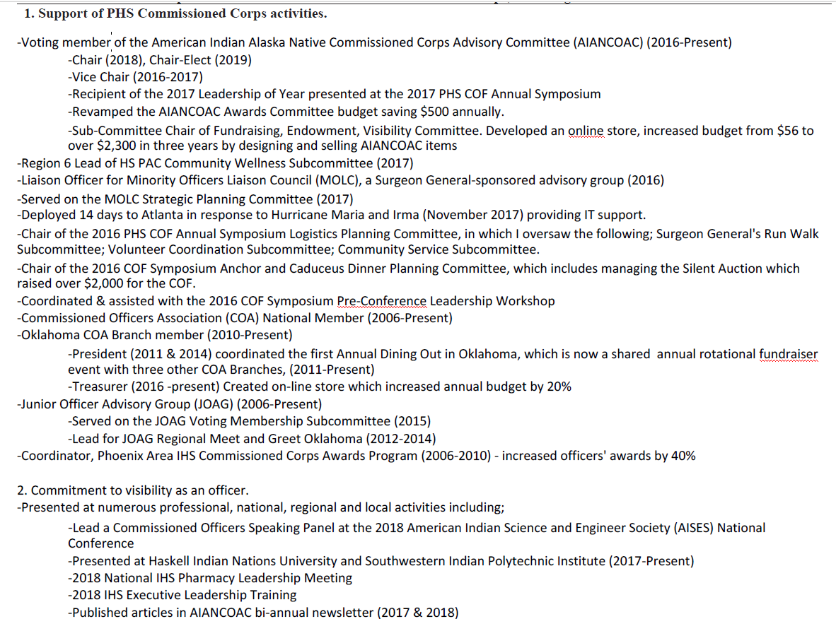
Purposeful Promotion Documents
Officer Statement (OS)

Slide 19
Purposeful Promotion Documents
Reviewing Official’s Statement (ROS)
Allows the Agency to provide input:
  Promotion readiness
  Leadership attributes
  Contributions to the agency mission
Reviewing Official
  Federal Supervisor if detailed through MOA to Tribal Org
  2nd line supervisor if assigned to a federal site
Last page of the current online COER (or PDF if officer completed a transfer COER as the Annual COER)
Notes:
The Reviewing Official (RO) is typically the same RO for the COER but doesn’t have to be.
The following factors are addressed in the ROS:
Promotion Readiness: Is the officer ready for promotion and to serve at the next higher rank? [Yes/No]. Explain:
Leadership: How does the officer take on a leadership role in the OPDIV/STAFFDIV/organization?
Mission: How does the officer contribute to the mission of the OPDIV/STAFFDIV/organization?
The ROS is now part of the Annual COER, typically the last page of the online COER.
For the small percentage of officers who completed a transfer COER that will stand as the Annual COER (To date was July 1 or later), the ROS is accessed from the CCMIS website and the Reviewing Official MUST use the current year’s version when completing this form. The manual PDF ROS is submitted through the Regional Liaison.

Slide 20
Purposeful Promotion Documents
Reviewing Official’s Statement (ROS)
Inform supervisor and RO well in advance
Provide link to the ROS section of the Promotions menu
Draft supporting document
Focus is on agency/command (NOT Corps!) contribution
Paragraphs may be more valuable than bullets
Use to confirm statements in other documents and/or address perceived weaknesses.
Notes:
Assist your RO by providing them with statements demonstrating your readiness for promotion, your leadership attributes, and your contributions to the agency mission. This is not where you talk about all of your officership activities. This is about the agency mission.
Great place to address actual or perceived weaknesses, like if you lack mobility. Who better to convey how valuable you are and how difficult the position would be to fill without you (if that is the case), than your RO?
If you have tons of collateral and acting duties, mention it here along with the impact of you filling those gaps (operations, patient care, cost-savings, etc.) Ensure the info listed demonstrates your leadership and readiness for the next rank.

Slide 21
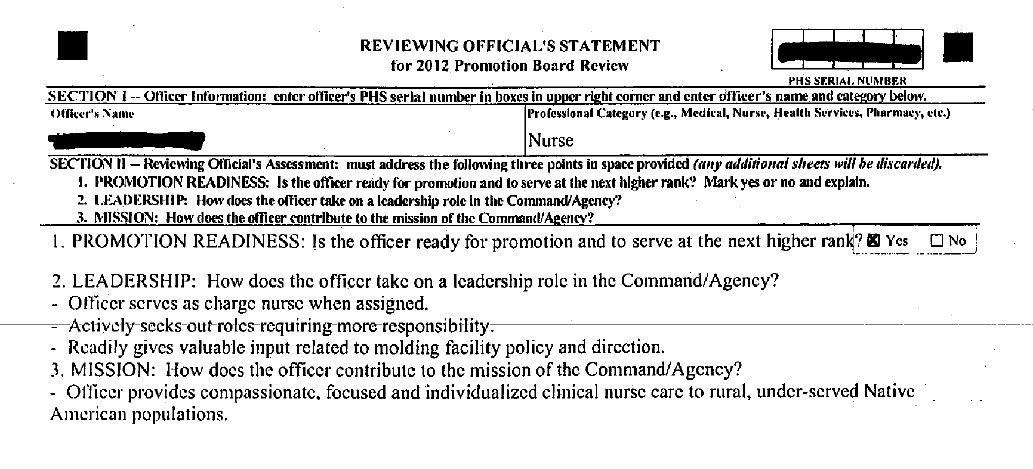
Purposeful Promotion Documents
Less than Ideal
Reviewing Official’s Statement (ROS)

Slide 22
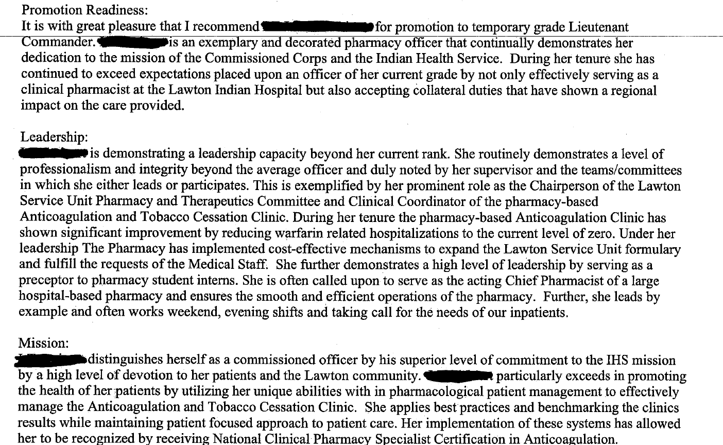
Purposeful Promotion Documents
Reviewing Official’s Statement (ROS)
Notes:
Very readable and not all running together.
There are trigger words that give the impression this RO took the time and care to draft this and he/she cares about the officer. “it is with great pleasure”, the officer “is demonstrating a leadership capacity beyond her current rank.” The officer “distinguishes herself as a commissioned officer by… superior level of commitment to the IHS mission by a high level of devotion to her patients and the Lawton community.”
See how paragraphs allow a story to be told and a picture painted versus bullets. So I prefer paragraphs for the ROS but bullets for the OS, which is just about activities and contribution.

Slide 23
ADMINISTRATIVE REQUIREMENTS
Notes:
Regardless of board score, you must meet these to be promoted

Slide 24
Administrative Requirements
Regardless of score, these must be met in order to be promoted
Temporary Grade
Required Annual COERs on file (last 5 years)
A current satisfactory COER, if required
A current valid license, if applicable
No current or pending adverse actions
Meet and maintain basic level of readiness
Notes:
Readiness – condition of service – Corps has moved to reviewing readiness continually and having consequences for not being ready (anytime and not just at promotion time).
These all used to be applied after the boards adjourned, but not are used to determine eligibility: You must meet these between September and January 1 or you will not even be reviewed by a promotion board, pursuant to POM 821.74

Slide 25
Administrative Requirements
Regardless of score, these must be met in order to be promoted
Permanent Grade
A current satisfactory COER, if required
Valid license
No current or pending adverse actions
Meet & maintain basic level of readiness
Current 5 year Physical Exam on file w/Med. Affairs
Report of Medical History (DD2807-1) and
Disclosure Statement dated within 1 year of Apr. 30 of the promotion year
Notes:
DD2807-1 dated between May 1, 2019 and April 30, 2020 for this upcoming promotion year. If you are up for your 5 year physical exam, this form is part of it and needs to be completed by your provider. If you are not up for the 5 year physical, it is self-completed and you don’t sign it. You sign and date the accompanying Disclosure Statement form.

Slide 26
TIPS TO TAKE AWAY

Slide 27
Additional Tips to Take Away
Remember the basics
  Name and Serno on all documents
  Adhere to formatting guidelines
  Verify all documents are in the eOPF
  Adhere to all deadlines on the Promotion Checklist
Fulfill all administrative requirements
  Not just at promotion time, but at all times

Slide 28
Tips to Prepare
Do not give up!
Take responsibility for your promotion
Confirm submitted documents are in the eOPF
Ensure current credentials in the eOPF at all times
Ensure the PIR/eOPF are correct
  Submit corrections to phsopffix@hhs.gov (contact us first)
Always keep proof of submission
Notes:
Always look in your eOPF to confirm that your documents made it and are legible. Don’t rely solely on the automated email. Verify.
Licenses/Credentials should NEVER expire in the eOPF. They must be current on file.
Should your document not make it to the eOPF in time, you may have recourse if you have evidence that you uploaded/submitted the documents.
PHSOpffix cannot add docs to your eOPF; it can only correct errors currently in the file
PIR errors can severely hurt an officer’s chance for promotion. Check your COER scores, transfer history, licensure status, current billet grade, etc.

Slide 29
Tips to Prepare
Ensure the CV is formatted correctly & shows impact
Do not embellish
Back up CV claims with documentation
Be concise and clear
Be familiar with the Benchmarks, Policy, and POM
Be familiar with the Promotion website and deadlines
Assist the Reviewing Official with the ROS
Notes:
A legible PHS Serno helps ensure your documents make it to your file.
Should your document not make it to the eOPF in time, you may have recourse if you have evidence that you uploaded the documents.
Boards want to see the impact of your duties or membership.
Board members have been around the block so they can tell when you are inflating what you’ve done. They may also know you, so you don’t want to call into question your integrity.
Transcripts should show work on an advanced degree. Letter of appreciation can show contribution to JOAG, PAC, COA, etc. As much as possible, back up your claims with documentation.
Notify your RO and supervisor by email that you are eligible for promotion and provide him/her your full name, PHS #, category and the link to the ROS page on the Promotion Information Page. In the email, provide him/her with bullet points to help identify how you are ready for promotion, demonstrate leadership in the agency/command and contribute the agency mission.

Slide 30
Tips to Prepare
Spend appropriate time on the OS
  Consider your community activities and how to promote the Corps as an officer and reflect it on the OS
  Focus on PHS support activities, not your day-to-day job duties
Consider rebutting a COER with which you do not concur (by Dec. 31 if eligible for promotion)
Verify all required COERs are in the eOPF
Do not wait until the eOPF deadline if possible
Seek help when needed
Notes:
Put in the time and effort on the OS. It’s the most important document for Precept 4: Officership.
Make it easy for the boards by being concise & clearly show how you measure up against the benchmarks.
Submit a rebuttal by December 31st if you want it to be seen by a promotion board. It must be in your file by the time they upload files for the board viewer typically in late January.
Waiting until close to the deadline to submit documents may increase the chances that your documents will get caught in a backlog, or technical glitch, and/or get misfiled.
Begin your preparation well before you are eligible, whenever possible. Don’t chase promotions, but always seek improvement, growth, and development for professional fulfillment and to position yourself for promotion.

Slide 31
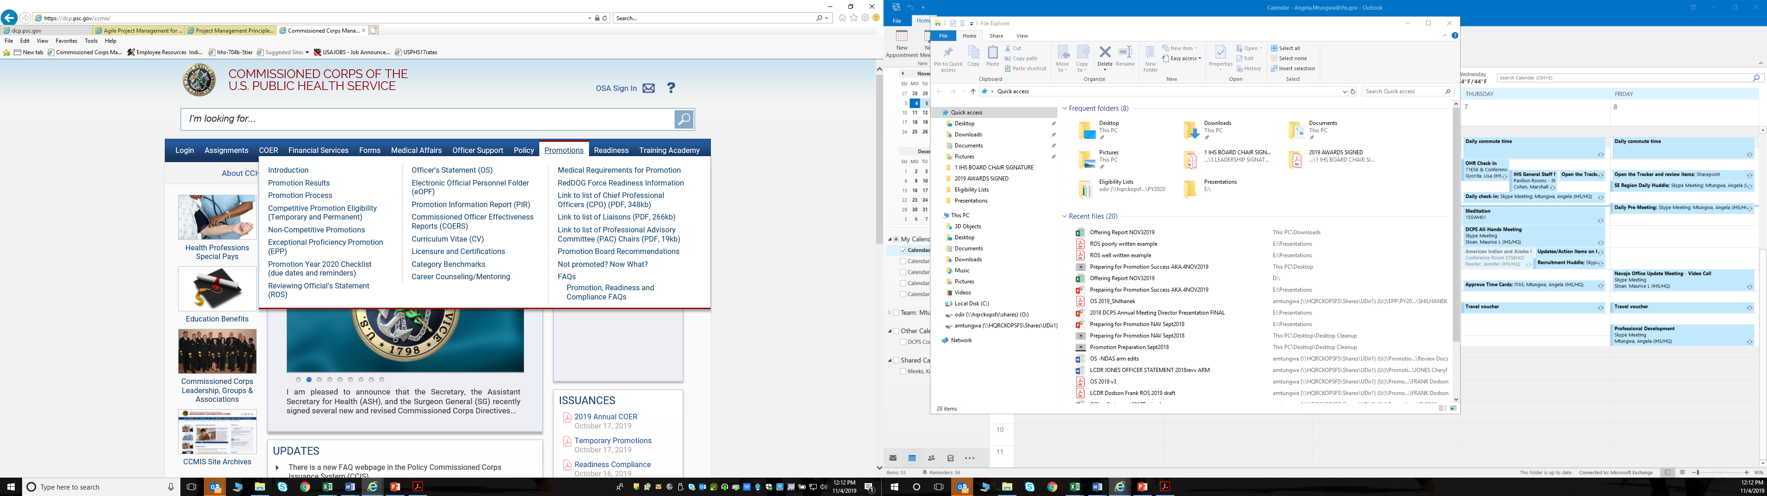
Where to Find Help
From the CCMIS website: dcp.psc.gov/ccmis/

Slide 32
Where to Find Help
Directive/Policy/POM:
  Book: 1, Chapter: 2, Section 2, Instruction: 01 (CCD 122.01)
  Book: 3, Chapter: 3, Sections 1, 2, and 3
    CCI 331.01 – Permanent Grade
    CCI 332.01 – Temporary Grade
    CCI 333.01 – Failure to Promote
  Book 8, Chapter 2, Section 1
    POM 821.74
Your IHS Regional CC/DCPS Liaison Office
Category PAC/PAG*
Notes:
Always good to know the governing directives/regulations and policies for yourself.
After familiarizing yourself with policy, your IHS Commissioned Corps Liaison is your next best option. That’s why we are here.
I am so impressed with IHS officers who work so hard without complaint in some tough environments. You all are doing great work. It’s really a matter of presenting it well on the page through well-crafted documents and addressing areas of weakness, and making sure you have some acknowledgment of your great work in the form of individual honor awards in your file.
Your category’s Professional Advisory Cmte (PAC) also has resources for professional development, mentoring, and promotion prep.
Well-meaning officers can give wrong information; ensure you are going to subject-matter experts

Slide 33
Summary
Familiarize yourself with the promotion process
Start planning early and be judicious
Tailor documents to the audience and goals
Submit supporting documentation
Utilize available resources
FOLLOW UP to ensure a complete, accurate record

Slide 34

Thank you!
Best wishes for Promotion Success

