Slide 1
Commissioned Corps Awards Overview
Alaska Area Awards Board:
CDR Katie Jacques
CDR Scott Mitchell
LCDR Joy Callaway

Slide 2
Objectives
Meet the Alaska Area Awards Board Members
Review Structure of AAAB
Review Available Resources for Awards Writing
Overview of Award Types and Structure
Take the Time to Highlight Your Work… It’s Award Worthy!

Slide 3
Meet the board
CDR Seth Green at-Large Diet, Sci, Medical)Alt: Vacant position
CDR Jennifer Dobson Environmental Health Category, Alt: CDR Brian Lefferts
CDR Christopher Fehrman (Co-Chair) Engineer, Alt: CDR Shad Schoppert
LCDR Joy Callaway Nurse Category, Alt: CDR Jodi Sides
LCDR Max Klingenstein Dental Category, Alt: LCDR Nhi Huynh
CDR Jasen Thompson HSO Category, Alt: LCDR Michael Bakker
CAPT Aimee Young (Co-Chair) Pharmacist Category, Alt: LCDR Madalene Mandap
CDR Katie Jacques Therapist Category, Alt: CDR Scott Mitchell
Katya Terekhova Recorder, Alt: Sonya Lord, & Mya Renken

Slide 4
When do we meet
Alaska area awards board meets the last Friday of every month, nominations are due by the 10th of each month.
IHS awards board also meets monthly on the last Wednesday of the month.

Slide 5
Policy
CCI 511.01 “Awards Program” effective 30 April 2020
CCI 512.01 “Wear of Awards and Badges” effective 30 April 2020
POM 821.14 “Awards Processing” effective 25 June 2020

Slide 6
Local resources
Aurora Borealis COA Website- Awards
Awards Process Presentation 2020 by Ms. Robin Davidson
Recorded presentation, “Awards Part II: Submission of Awards Package” by Ms. Robin Davidson, 2020
Nomination package forms
Alaska Area Awards Board Coordinator contact info

Slide 7
Us!
At any time, you can reach out to an AAAB member.
Other structures that exist:
SCF Pharmacy Department Awards Committee
Meets monthly
Mike Beiergrohslein, Heidi Brainerd, Calista Carlton, Tiffany D'Atri, Brian McKnight, Deb Tobuk, Kristen Maves
SCF RN Awards and Peer support Committee
Meets monthly
SCFRNAwardsCommittee@southcentralfoundation.com
Review award write-ups to assist nurse discipline and managers sending to the Alaska Area Awards board.
Review changes in USPHS affecting the nurse category peer/group support
Interested in helping- connect with your category board representatives.

Slide 8
National Resources
Commisioned Officer's Awards Program (COAP):
Nominations Procedures and Forms
Eligibility to Receive Awards
Approval Levels
Types of Recognition & Awards Criteria
Non-PHS Awards
Write-Up (Narrative) Guidance & Tips
List of OPDIV Awards Coordinators (PDF, 67kb)
List of Liaisons (PDF, 266kb)
2021 USPHS Awards Process Flowchart (PDF, 702kb)
FAQs
PHS Award Recipients

Slide 9
SUBMITTING A NOMINATION FOR AN HONOR AWARD
Two separate forms must be submitted electronically via email for each Honor Award nomination
Honor Award Nomination Record (PDF-fillable form)
PHS-6342-2 for individual award
PHS-6342-1 for unit award
All nominations should have at least one level of Supervisory/Line Authority review and endorsement.
Please utilize digital/electronic signatures whenever possible
2) One-page Narrative write-up that describes the accomplishments or project that is being submitted for the award

Slide 10
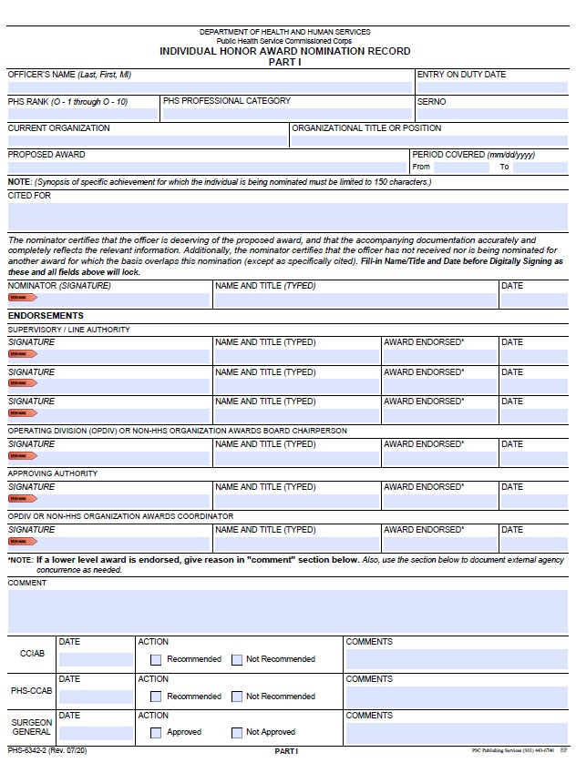

Slide 13
header/Top of the narrative
NAME OF AWARD
RANK AND NAME OF OFFICER

Slide 14
Opening statement/INTRODUCTION
Do not label this paragraph
Tells which award the Officer is being nominated for, a general description of the activity being recognized, location, and time frame for the activity. The time frame must be closed-ended (already completed) and match the dates on the Nomination Record Form.

Slide 15
Background/summary of award
Why was this activity or special action needed? What was the need at the Service Unit or location so that the activity was able to make an impact?
You can label this paragraph as Background.

Slide 16
Accomplishments and impact
These two sections are the most important part of the award write-up
These should be either two distinct and labeled sections (this one makes it easier to find the contents) or identified as a combined Accomplishments/Impact section

Slide 17
accomplishments
What was actually performed by the Officer? This can be a list of bulleted statements and is often more readable that way, rather than long paragraphs.
Numbers and data are helpful along with an explanation, if needed.
LABEL this section "Accomplishments"

Slide 18
impact
Why did the accomplishments matter?
What were the effect/s of the accomplishments?
What actual impact or change did they have on the target or receiving audience?
Data is important if available.
LABEL this section "Impact"
Money saved
People trained
Percentage of improvement

Slide 19
closing
Do not label this paragraph
Use the standard closing line:
The singularly distinctive accomplishments of (name) reflect the highest credit upon him/herself and the United States Public Health Service.

Slide 20
Example narratives

Slide 22
Award type overview- high overview
Individual Honor Awards
Distinguished Service Medal (DSM) Highest award granted: Health of the nation other initiative, act of heroism saving a life or protecting health.
Meritorious Service Medal (MSM) 2nd highest: single achievement or career notable accomplishments or high-quality leadership, heroics in an emergency.
Outstanding Service Medal (OSM) 3rd highest: outstanding leadership, single accomplishment that had a major effect or a heroic act.
The above may also be awarded with valor when recognizing acts of courage or bravery. (Not to be used for hazardous assignments or exposure to dangerous environments)

Slide 23
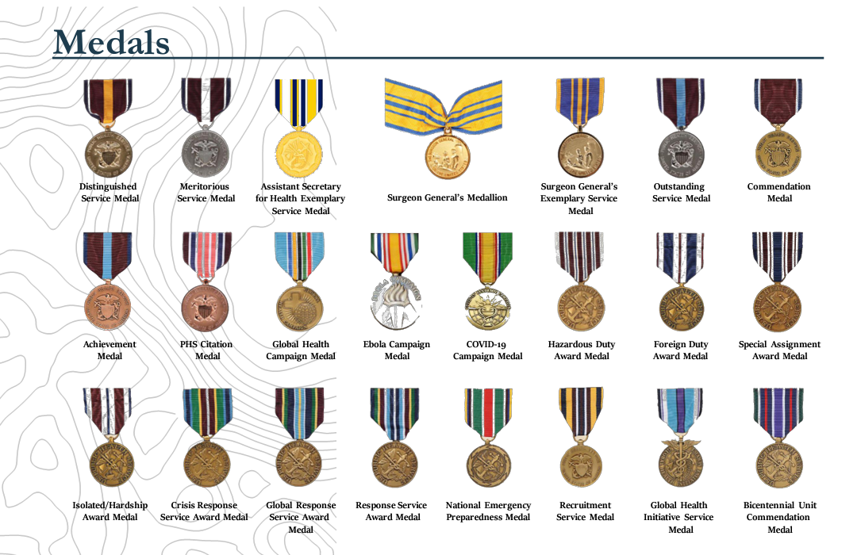

Slide 24
Award type cont..
Individual Honor Awards
Commendation Medal (CM) sustained high quality achievements, unique skill or approach to problem, noteworthy professional contributions.
Achievement Medal (AM) superior efforts in program mission, advancement of objectives, above average accomplishment or superior dedication to duty.
PHS Citation (CIT) specific and noteworthy achievement, generally for a short period of time.
The above awards are approved at the local level.

Slide 25
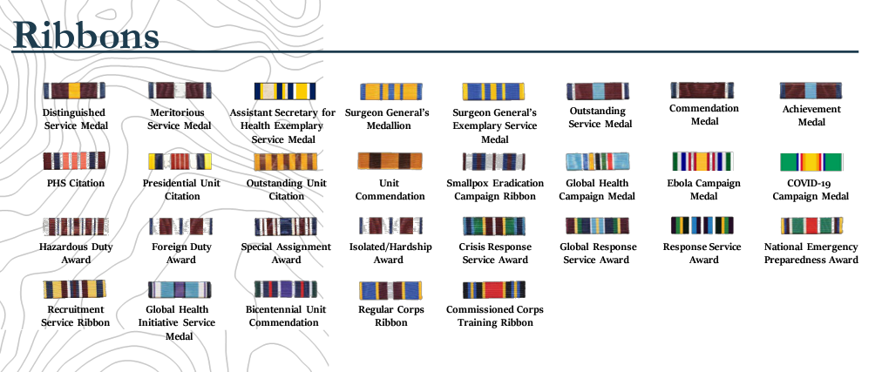

Slide 26
Award type cont..
Assistant Secretary for Health Awards
Assistant Secretary for Health's Exceptional Service Medallion (ASHM) awarded at the sole discretion of the ASH to a member of any uniformed service. No nomination and no ribbon associated.
Assistant Secretary for Health's Exceptional Service Medal (ASHEM) awarded at the sole discretion of an ASH who serves in uniform to a member of any uniformed service for the highest level of contributions to initiatives of the ASH.

Slide 28
Award type cont..
Unit Honor Awards
Presidential Unit Citation (PUC) Highest unit award issued to a uniform service, awarded to all officers who served satisfactorily on active duty during a certain period of time.
Outstanding Unit Citation (OUC) Granted to a group of officers who exhibit outstanding contributions toward achieving a goal and objectives of the Corps.
Unit Commendation (UC) Granted to acknowledge significant contributions and achievements well above that normally expected in accomplishing the goals and objectives to which the officers are detailed.

Slide 29
Award type Cont..
Campaign Medals
Smallpox Eradication Campaign Ribbon
Global Health Campaign Medal
Ebola Campaign Medal
COVID-19 Pandemic Campaign Medal (C-19CM)

Slide 30
Award type Cont..
Service Awards
Hazardous Duty Award (HDA)
Foreign Duty Award (FDA)
Special Assignment Award (SAA)
Isolated Hardship Award (ISOHAR)
Crisis Response Service Award (CRSA)
Global Response Service Award (GRSA)
Response Service Award (RSA)
National Emergency Preparedness Award (NEPA)
Recruitment Service Ribbon (RSR)
Global Health Initiatives Service Medal (GHISM)
Bicentennial Unit Commendation (BUC)

Slide 31
Awards Cont..
Other Ribbons
Regular Corps Ribbon (RCR): Officer who have been assimilated into the regular Corps.
Commissioned Corps Training Ribbon (CCTR): Awarded to officers upon satisfactory completion of Officer Basic Course.

Slide 32
Next steps…write…it’s your job and it's award worthy
Questions for the board??

